Slide 1



Helene Bieber - Communication
Sylvia Canonne - Anglais
Saé Territoires:
Lyon
BUT-2022
BESNIER Alexandre
BIGOT Nathan
DEBRAY Louis

Slide 2
Sommaire
I-Lyon the second economic city in France
a) An attractive metropolis
b) A student city
c) But with strong inequality
II-Culture
a) Son Histoire
b) Ses arrondissements
c) Ses évènements

Slide 3
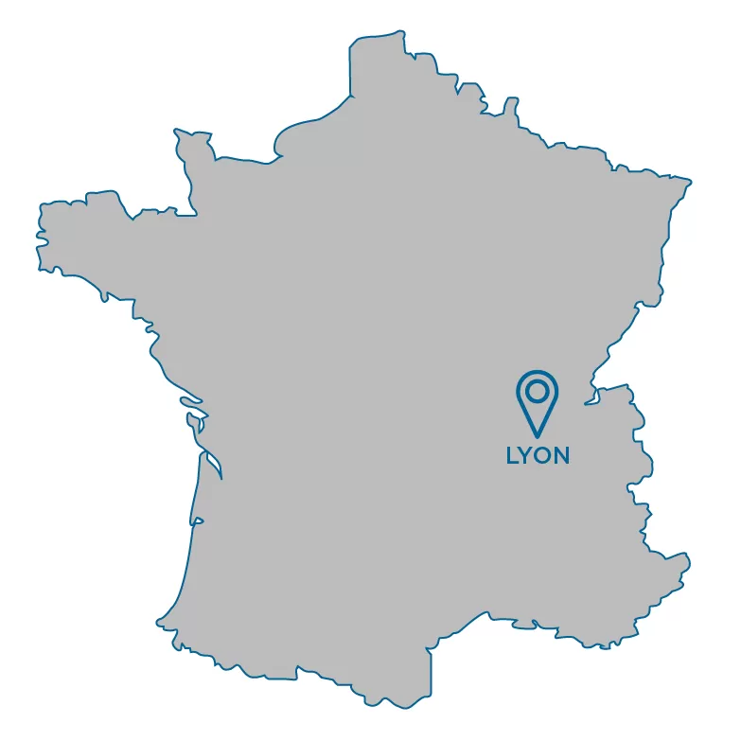
I-Lyon the second economic city in France II-Culture
a) An attractive metropolis a) Son Histoire
b) A student city b) Ses arrondissements
c) But with strong inequality c) Ses évènements
Inhabitant per km² :10,924.8
major industries
Map of Lyon location in Frane
1

Slide 4
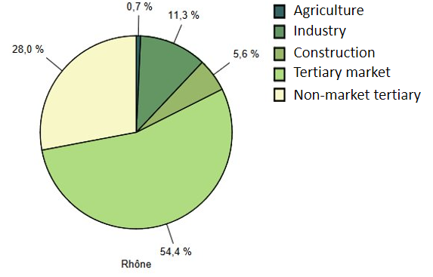
I-Lyon the second economic city in France II-Culture
a) An attractive metropolis a) Son Histoire
b) A student city b) Ses arrondissements
c) But with strong inequality c) Ses évènements
The first city for employment in France
Some important sectors of activity
Pie Chart of the Rhône total employment by sectors of activity. (2017)
2

Slide 5

I-Lyon the second economic city in France II-Culture
a) An attractive metropolis a) Son Histoire
b) A student city b) Ses arrondissements
c) But with strong inequality c) Ses évènements
one of the most attractive cities in France at European level.
Very high level scientific and commercial preparatory class
5th university town in France
Logo de l'Université de Lyon
3

Slide 6
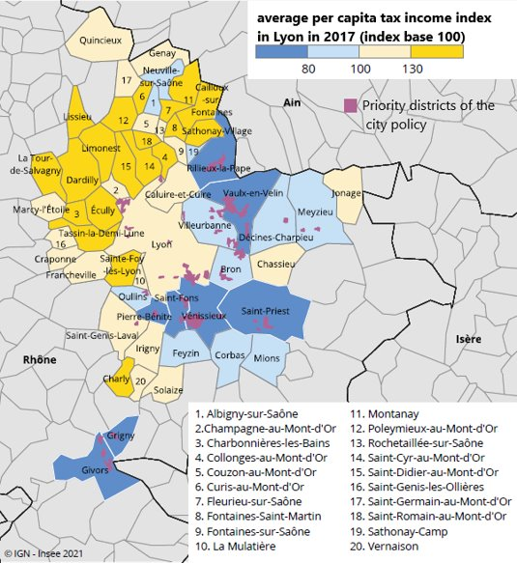
I-Lyon the second economic city in France II-Culture
a) An attractive metropolis a) Son Histoire
b) A student city b) Ses arrondissement
c) But with strong inequality c) Ses évènements
Important east west divides
Poverty rate of 15% in 2019
high real estate prices
Map of Lyon in average income
4

Slide 7
I-Lyon the second economic city in France II-Culture
a) An attractive metropolis a) Son Histoire
b) A student city b) Ses arrondissements
c) But with strong inequality c) Ses évènements
Lyon :
Second site de la Renaissance en Europe.
2ème ville culturelle et artistique de France.
5

Slide 8
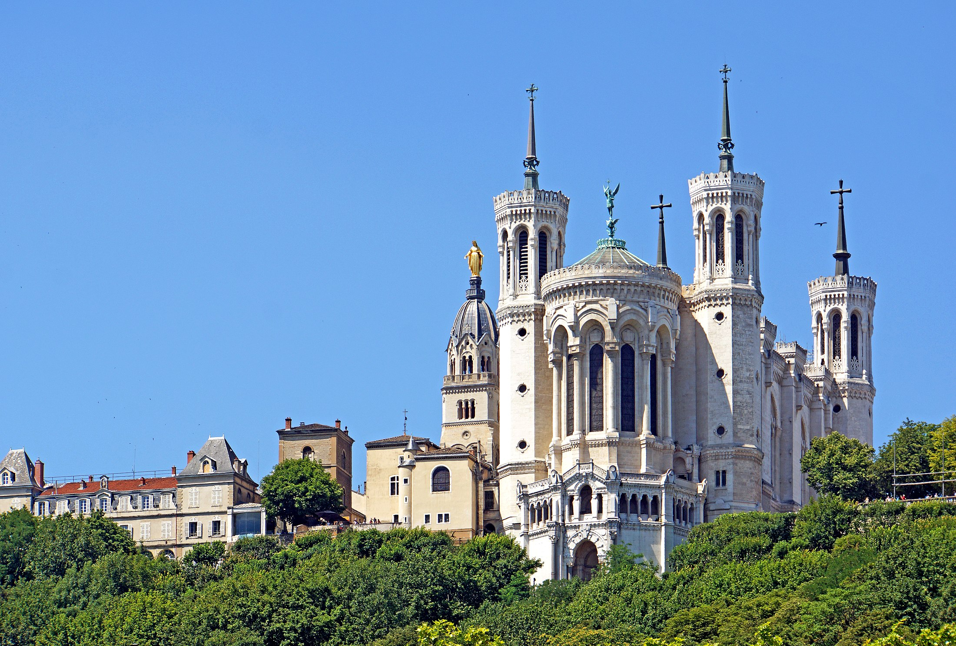
I-Lyon the second economic city in France II-Culture
a) An attractive metropolis a) Son Histoire
b) A student city b) Ses arrondissements
c) But with strong inequality c) Ses évènements
Une des premières villes d'Europe
162 édifices classées à l'UNESCO
Basilique Notre-Dame de Lyon
6

Slide 9
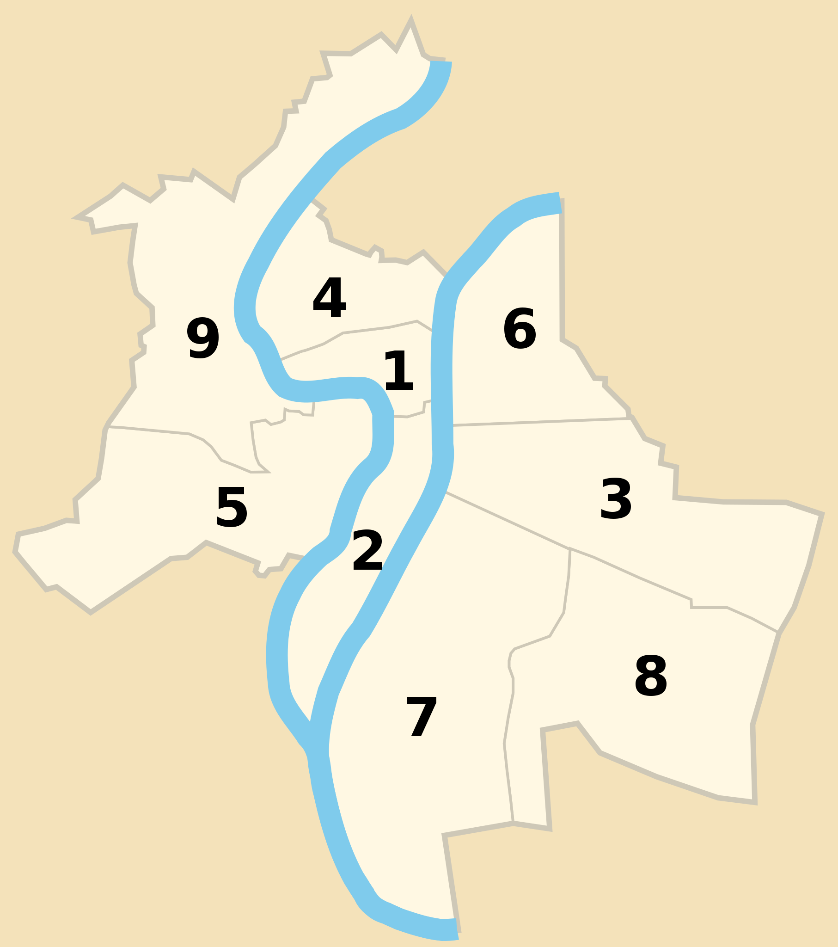
I-Lyon the second economic city in France II-Culture
a) An attractive metropolis a) Son Histoire
b) A student city b) Ses arrondissements
c) But with strong inequality c) Ses évènements
Des fonctions différentes
Lyon : Une ville accueillante
Une ville d'innovations
Arrondissements de Lyon
7

Slide 10
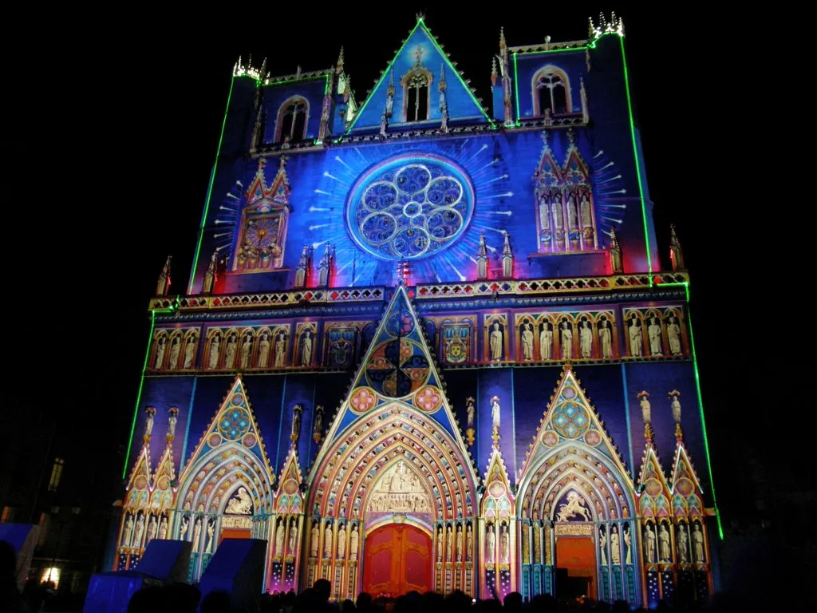
I-Lyon the second economic city in France II-Culture
a) An attractive metropolis a) Son Histoire
b) A student city b) Ses arrondissements
c) But with strong inequality c) Ses évènements
De nombreuses manifestations
Un partage culturel conséquent
Une culture sportive solide
Un rayonnement international
Cathédrale de Lyon illuminée pendent la Fête des Lumières
8

Slide 11
I-Lyon the second economic city in France II-Culture
a) An attractive metropolis a) Son Histoire
b) A student city b) Ses arrondissements
c) But with strong inequality c) Ses évènements
Conclusion
9

